Slide 1
Experiment to measure the Pockels effect from an HR AlGaAs coating (update)
LVK March 2021
Danny Vander-Hyde , Stefan Ballmer, and Steve Penn

Slide 2
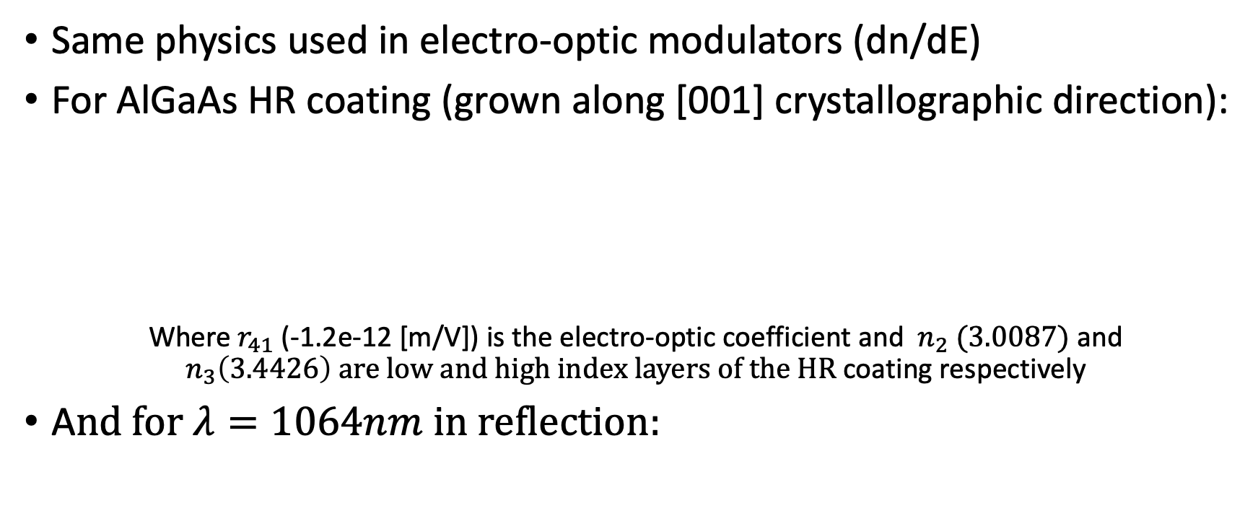
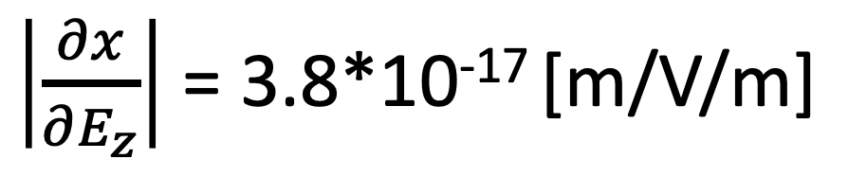
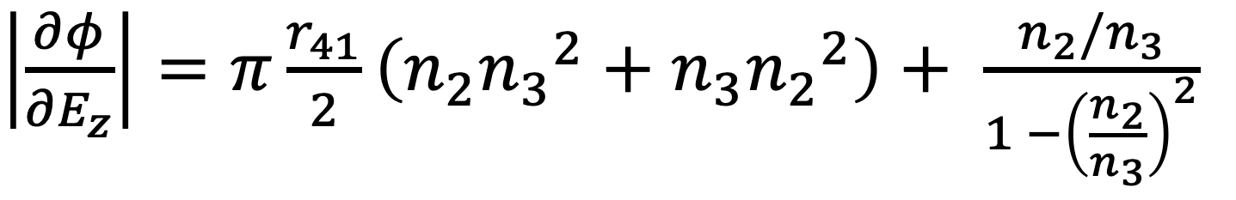
Pockels Effect (quick summary)
Same physics used in electro-optic modulators (dn/dE)
For AlGaAs HR coating (grown along [001] crystallographic direction):
Where $r_{41}$ (-1.2e-12 [m/V]) is the electro-optic coefficient and $n_{2} (3.0087)$ and $n_{3}\left(3.4426\right) are low and high index layers of the HR$ coating respectively
A$nd for λ=1064nm in reflection:$
$\left|\frac{∂φ}{{∂E}_{z}}\right|=π\frac{r_{41}}{2}\left(n_{2}{n_{3}}^{2}+n_{3}{n_{2}}^{2}\right)+ \frac{n_{2}/n_{3}}{1 −{\left(\frac{n_{2}}{n_{3}}\right)}^{2}}$
$\left|\frac{∂x}{{∂E}_{z}}\right|$ = 3.8*10⁻¹⁷ [m/V/m]

Slide 3
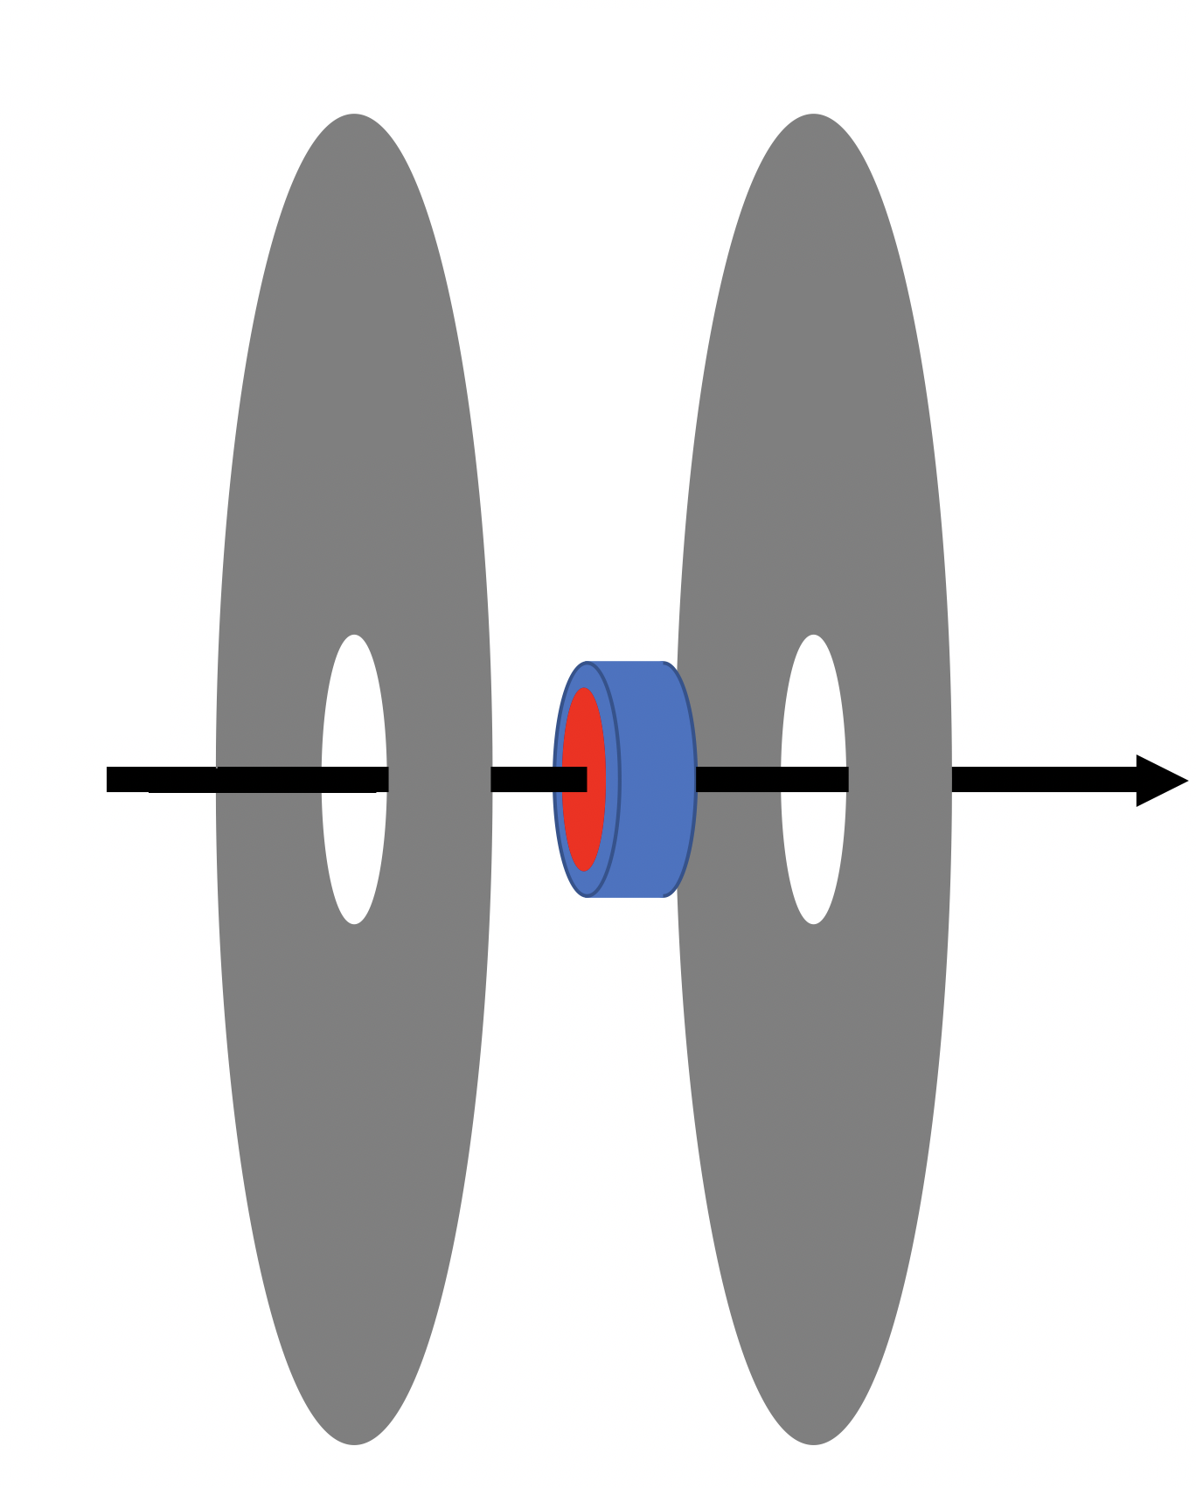
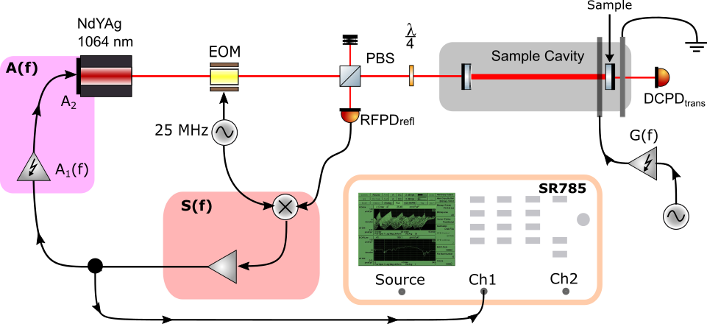
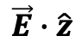
Experiment layout
$$\vec{E}∙\hat{z}$$
Notes:
PDH locked cavity with modulated voltage to electrodes from 1kHz to 30kHz

Slide 4
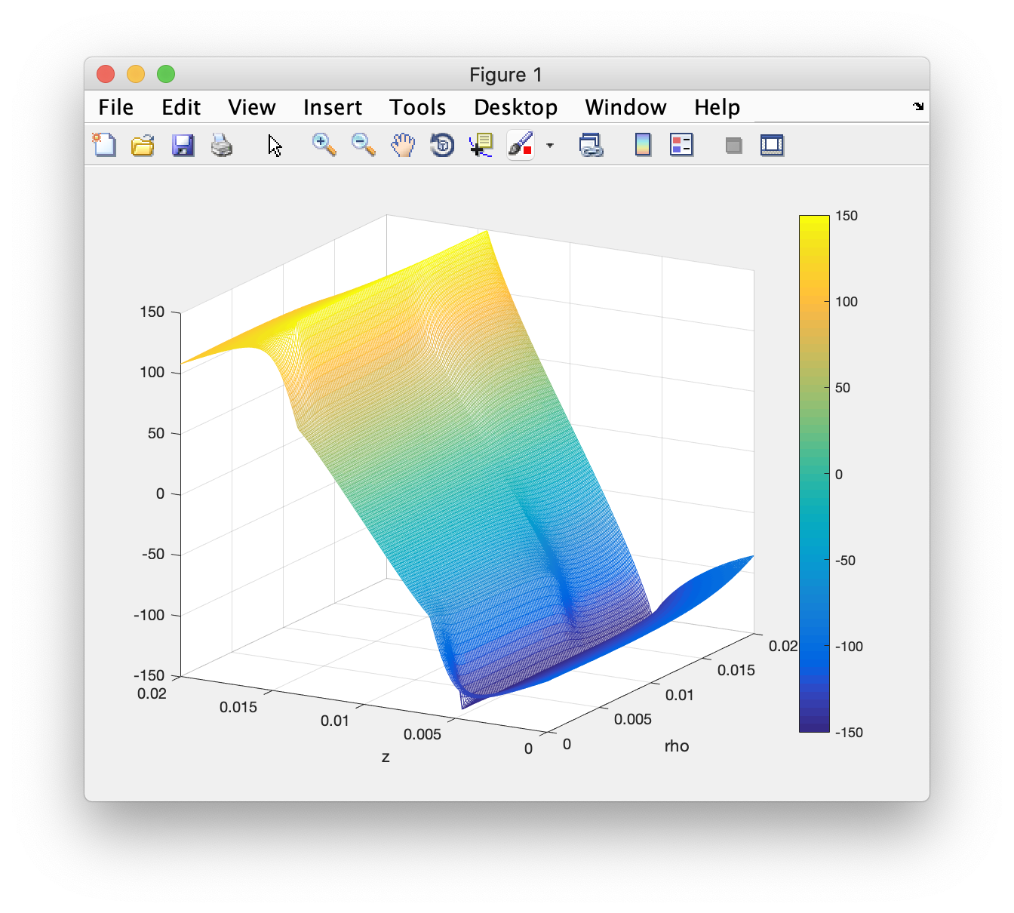
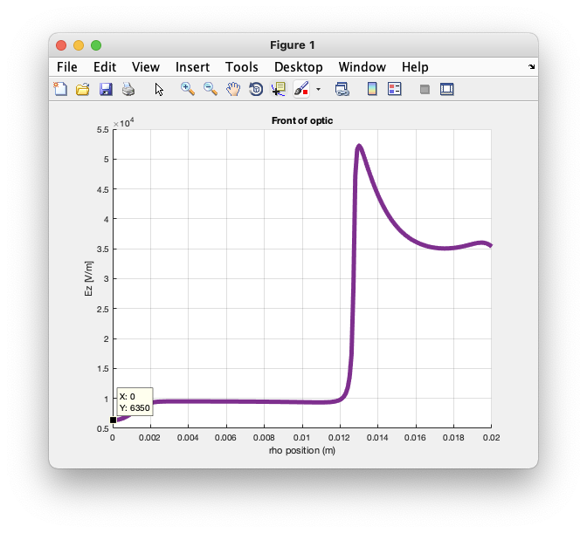
Electric field estimate within coating
E-field estimate at ROI:
6350 [V/m]

Slide 5
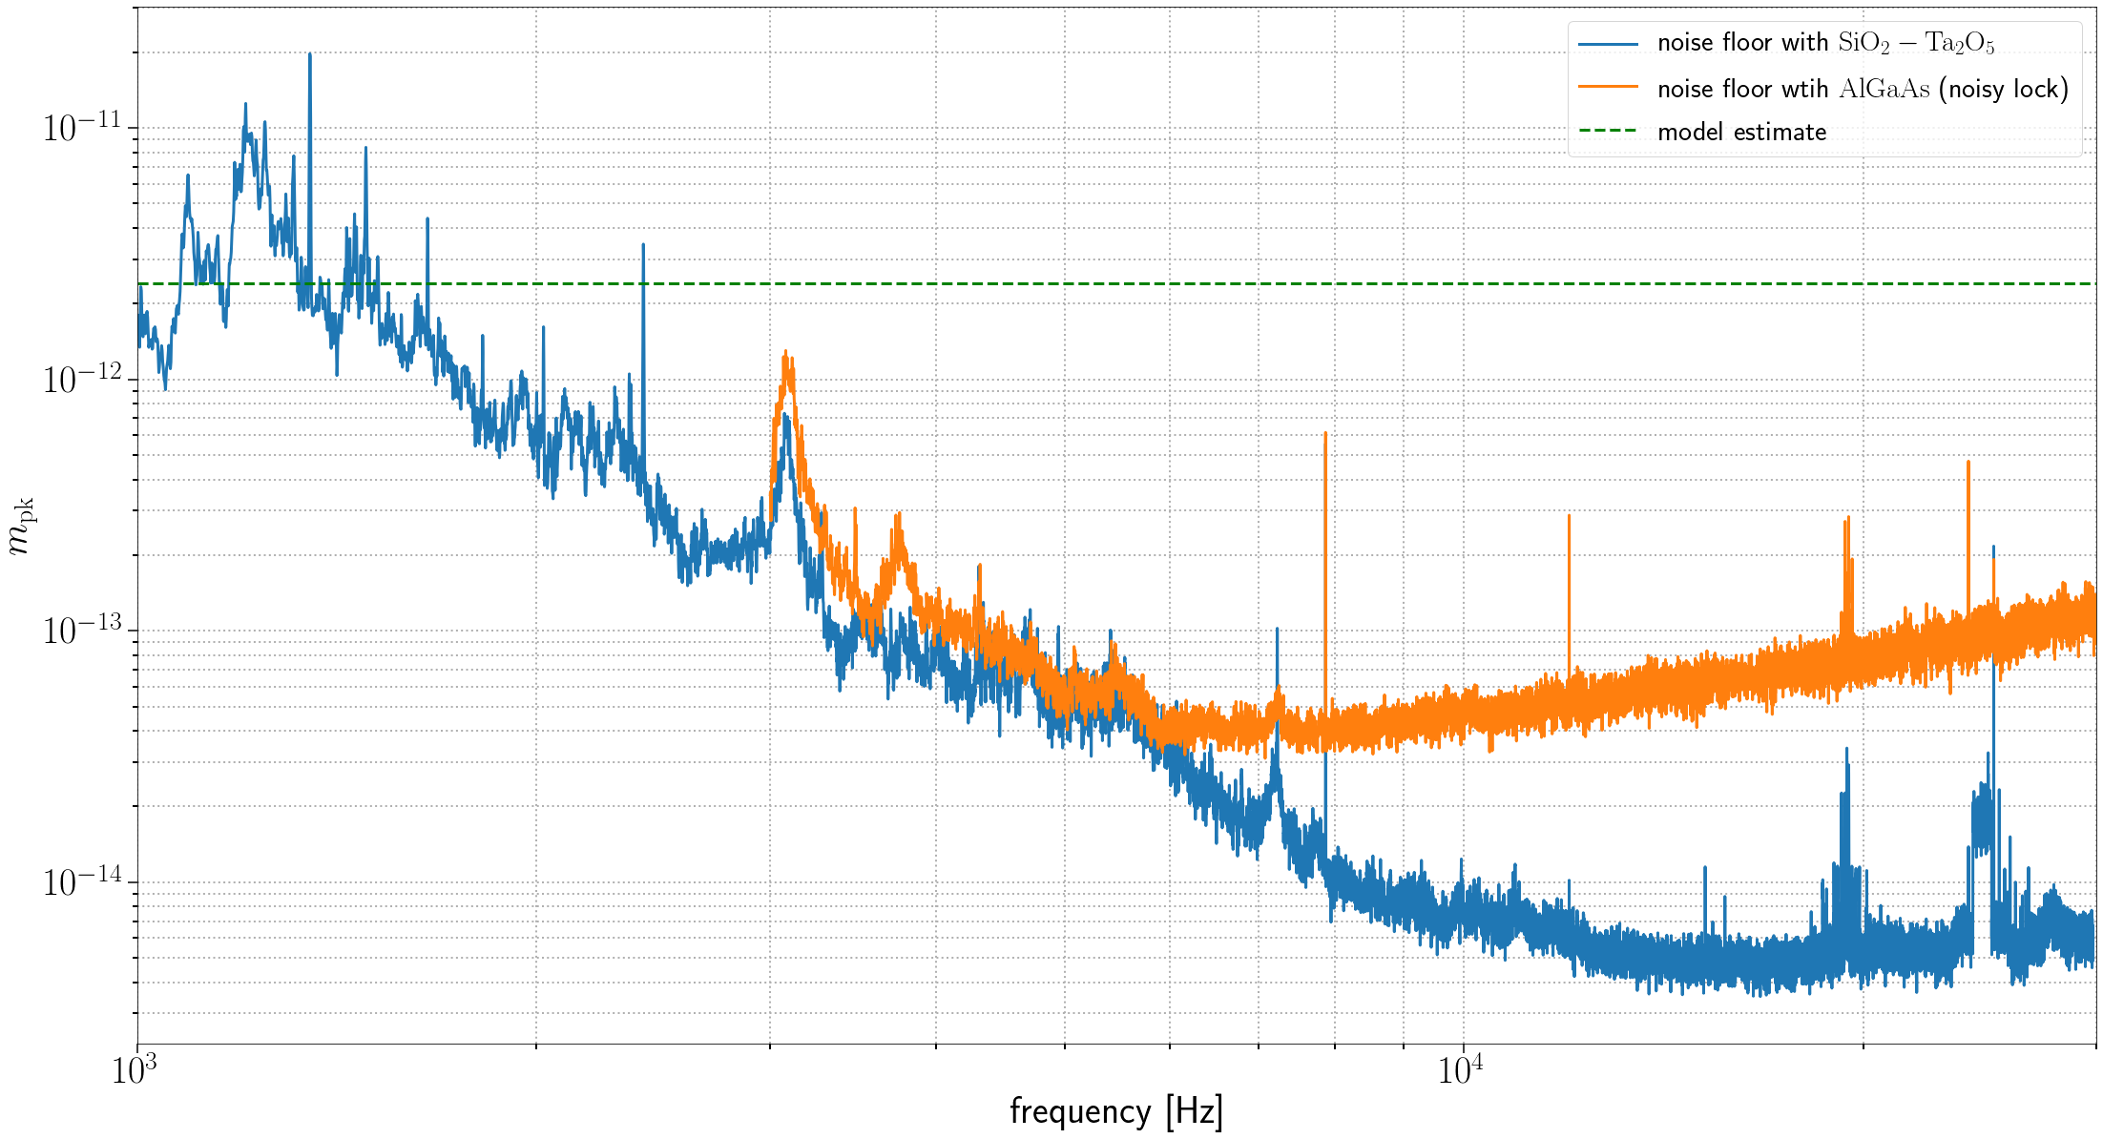
Measurable using in-air cavity

Slide 6
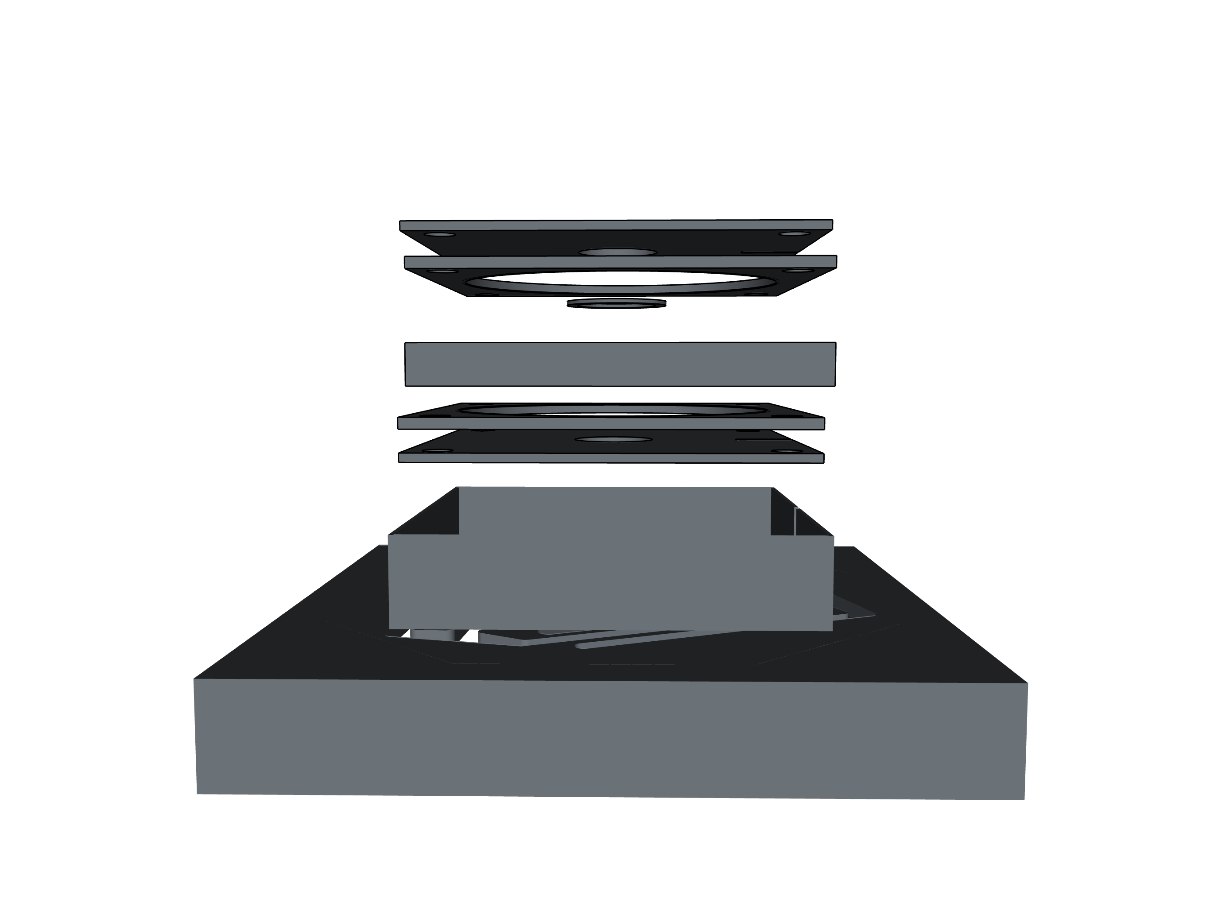
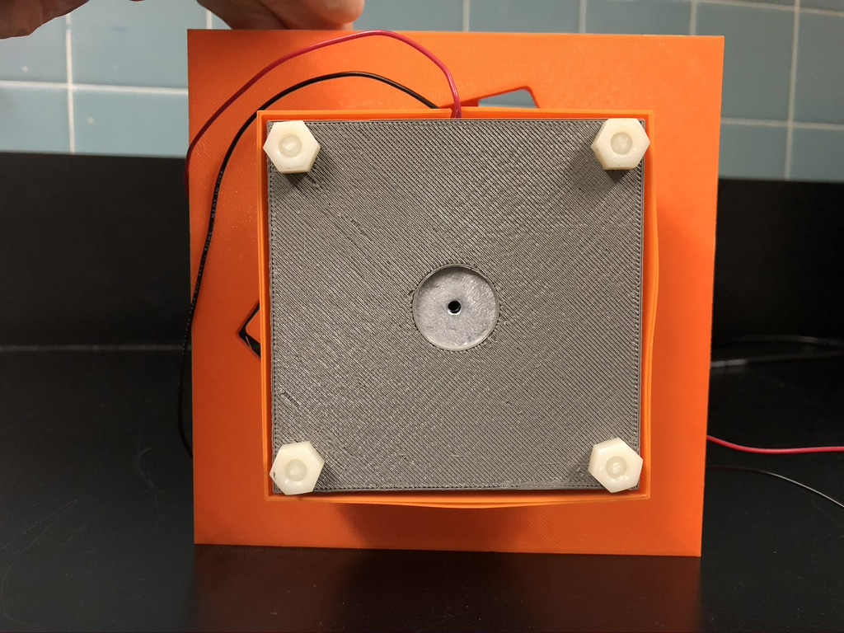
3D printed optical mount
Ortho-planar spring design for pitch and yaw control

Slide 7
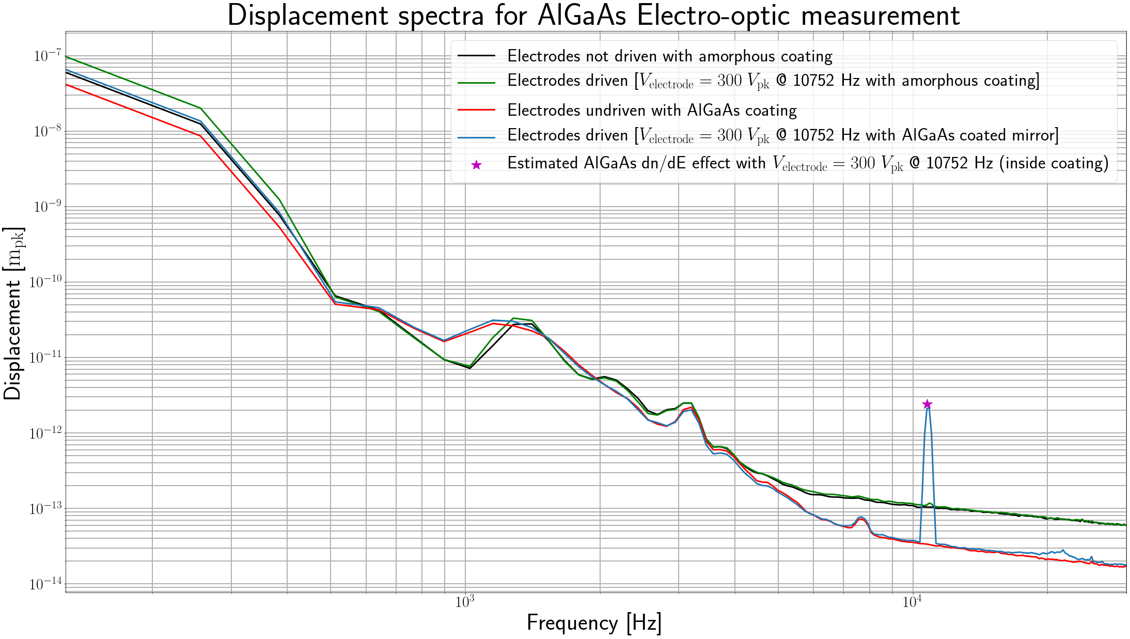
Previously reported single frequency drive results

Slide 8
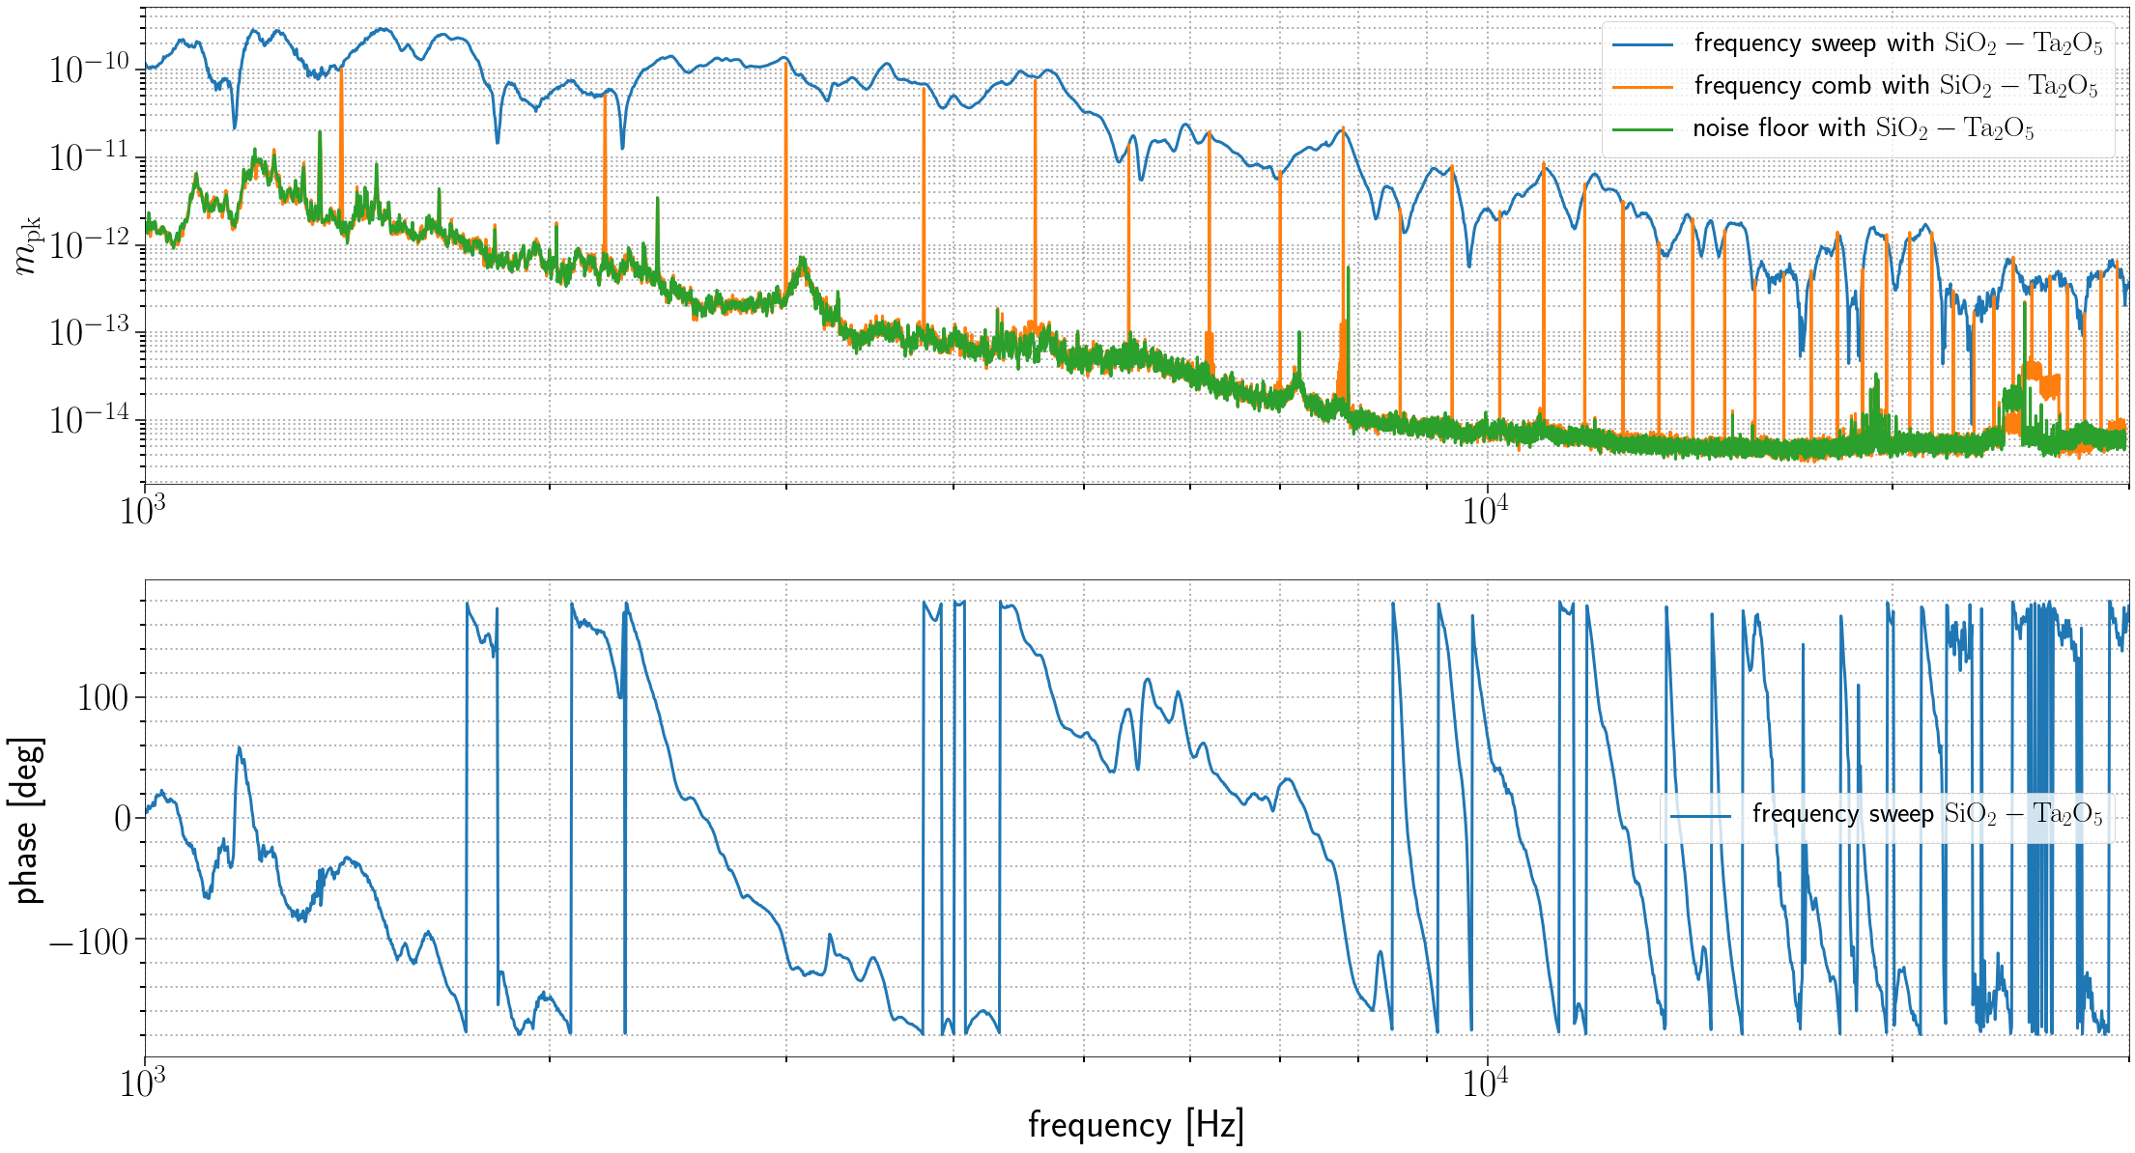
Frequency sweep test (SiO₂-Ta₂O₅ sample mirror)

Slide 9
Next Steps
Further investigation as to why we see the drive coupling into the PDH error signal for SiO₂/Ta₂O₅ sample
Potential mechanical instability of 3D printed mount
Electronics crosstalk
Once aforementioned coupling is addressed, attempt to measure Pockels effect with AlGaAs sample
Investment in calibration sample
Measure effect with separate individual polarizations

Slide 10
Refrences
Fejer, M.M. , Electro-optic Effects in AlGaAs mirrors , (2018)
Yariv, A., 1988, Quantum electronics, 3rd edn, (John Wiley & Sons)
BYU CMR, Ortho-planar spring design : https://www.thingiverse.com/thing:3007261

Slide 11
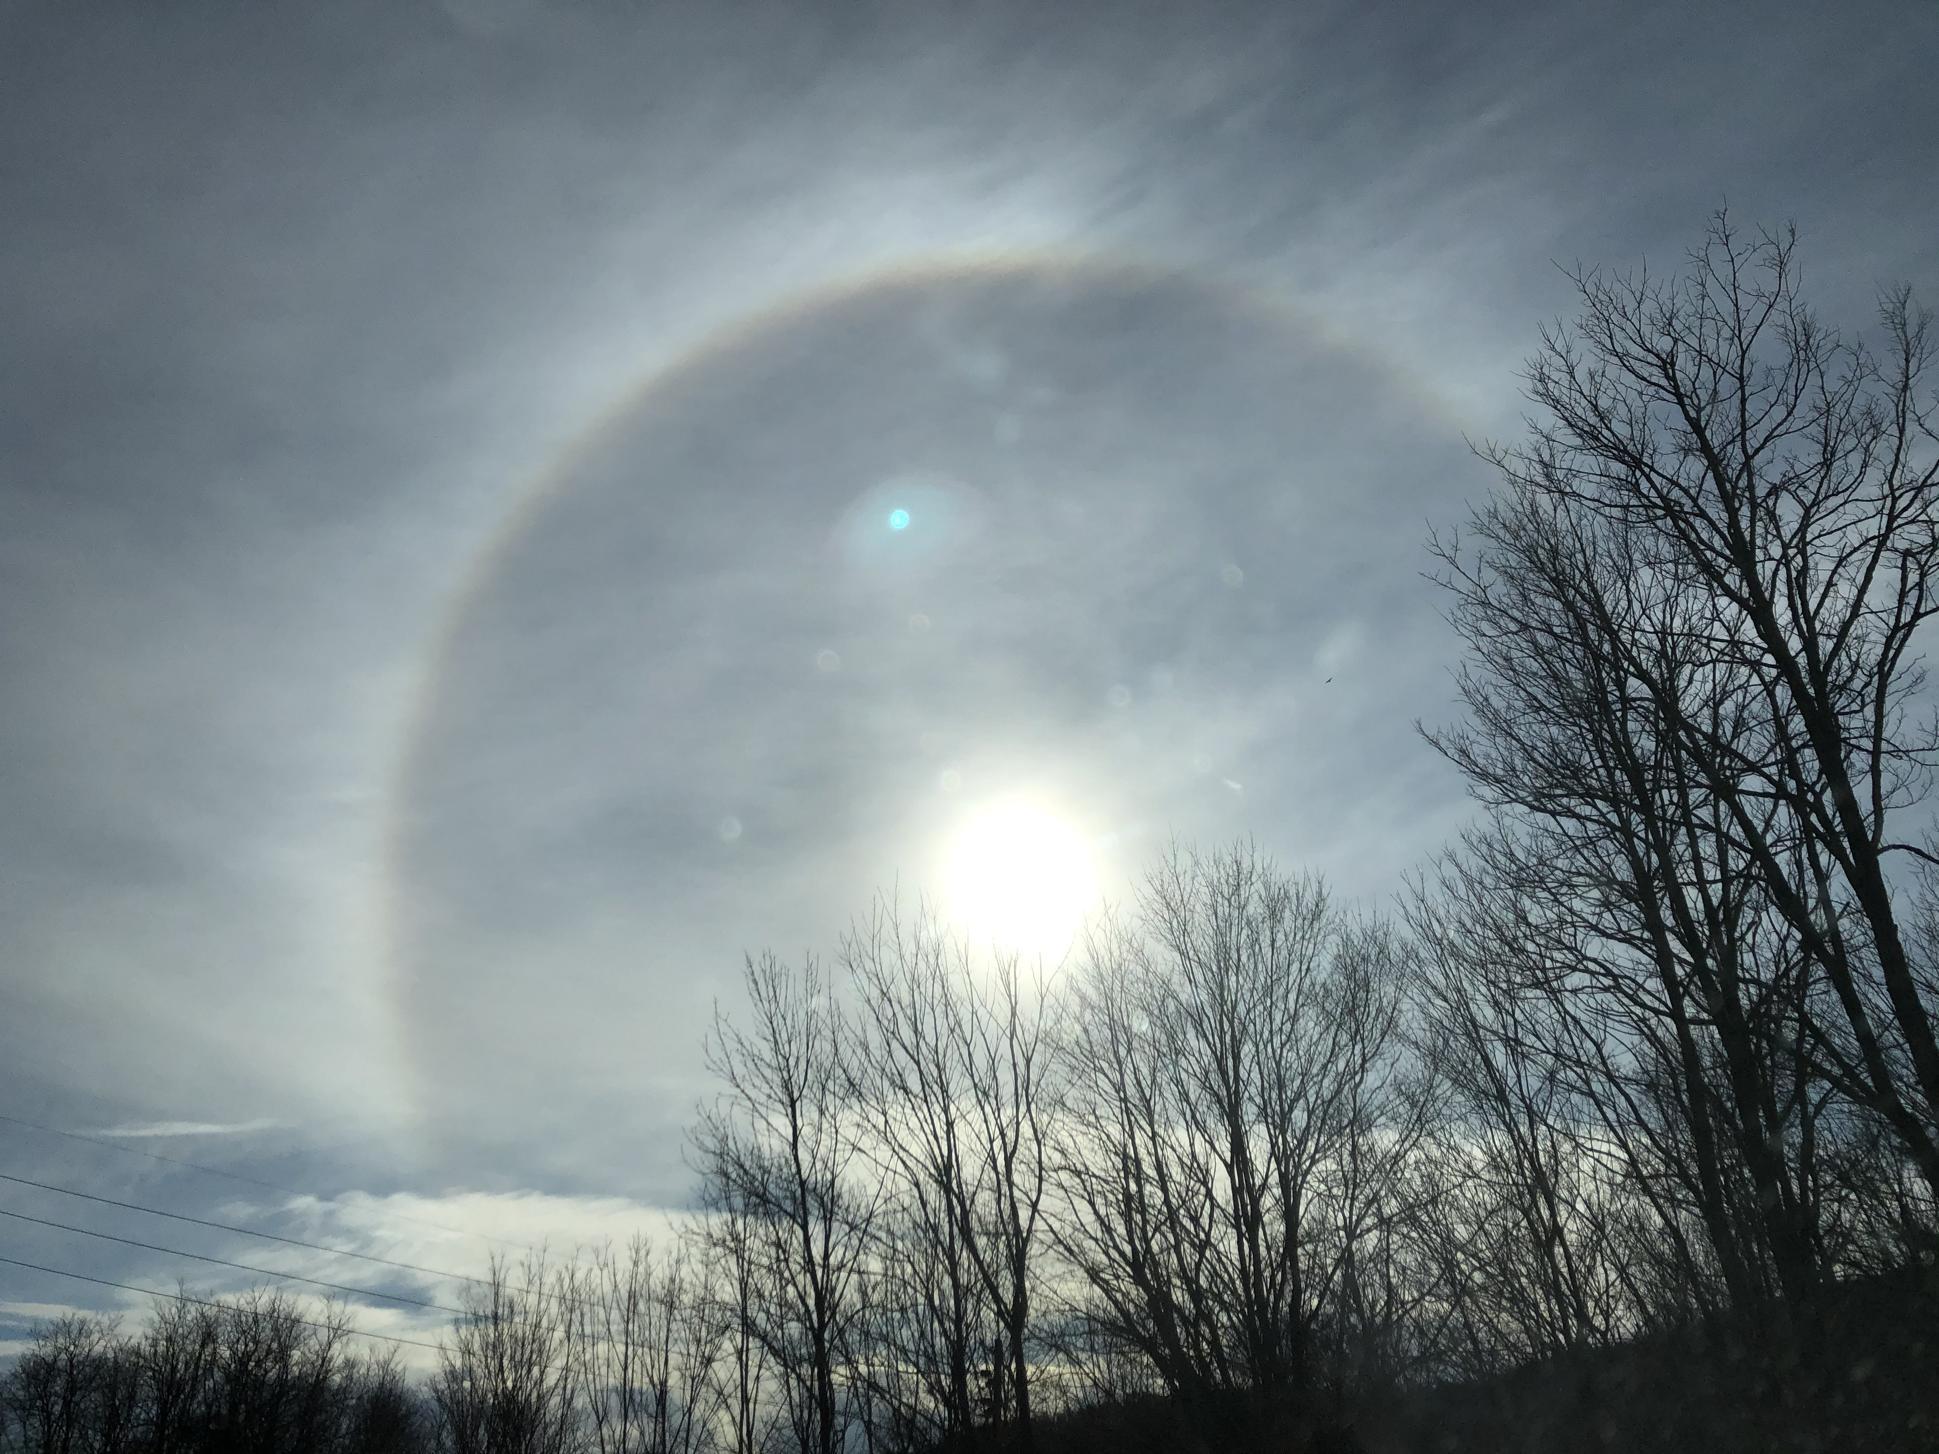
Thank you!
Questions? Suggestions?

Slide 12
EXTRA SLIDES

Slide 13
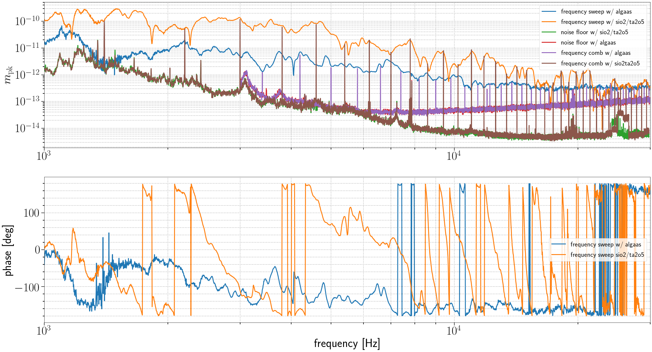
Frequency sweep test (both sample mirrors)

Slide 14
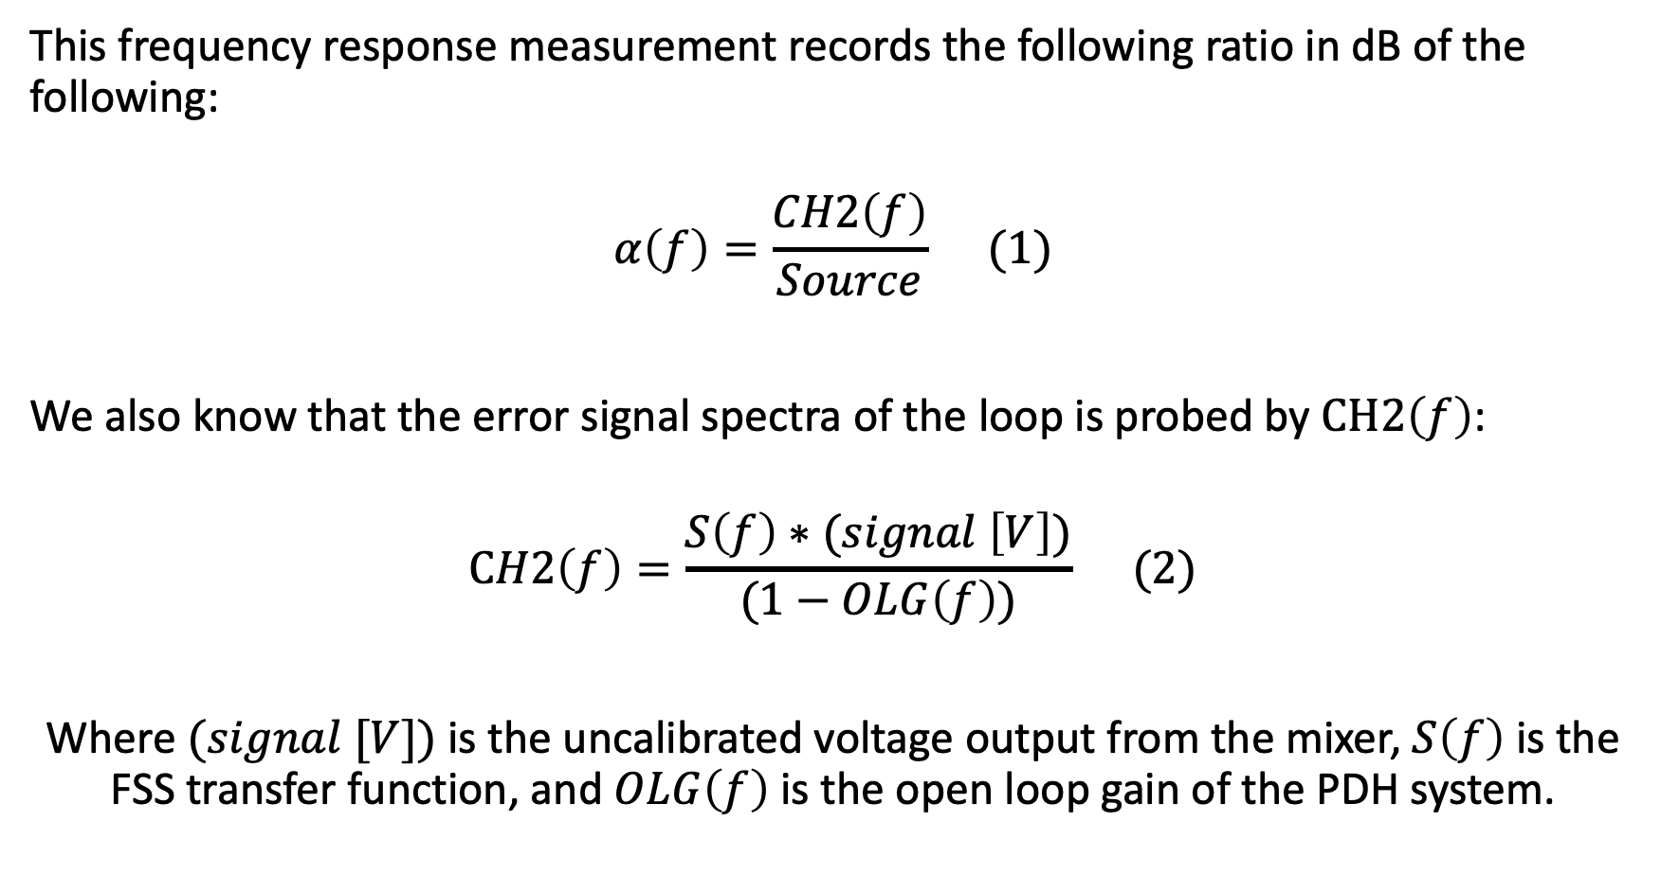
Calibration
This frequency response measurement records the following ratio in dB of the following:
$$α\left(f\right)=\frac{CH2\left(f\right)}{Source} (1)$$
We also know that the error signal spectra of the loop is probed by $CH2\left(f\right)$:
$$CH2\left(f\right)=\frac{S\left(f\right)∗(signal \left[V\right])}{(1−OLG\left(f\right))} (2)$$
Where $(signal [V])$is the uncalibrated voltage output from the mixer, $S\left(f\right)$ is the FSS transfer function, and $OLG\left(f\right)$ is the open loop gain of the PDH system.

Slide 15
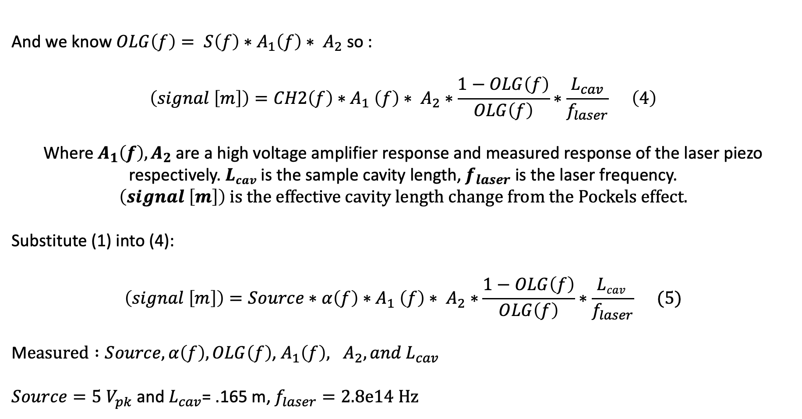
Calibration (cont.)
And we know $OLG\left(f\right)= S\left(f\right)∗A_{1}\left(f\right)∗ A_{2}$ so :
$$\left(signal \left[m\right]\right)=CH2\left(f\right){∗A}_{1}\left(f\right)∗ A_{2}∗\frac{1−OLG\left(f\right)}{OLG\left(f\right)}∗\frac{L_{cav}}{f_{laser}} \left(4\right)$$
Where $A_{1}\left(f\right), A_{2}$ are a high voltage amplifier response and measured response of the laser piezo respectively. $Lcav$ is the sample cavity length, $f_{laser}$ is the laser frequency. $\left(signal \left[m\right]\right) is the effective cavity length change from the Pockels effect.$
Substitute (1) into (4):
$$\left(signal \left[m\right]\right)=Source∗α\left(f\right){∗A}_{1}\left(f\right)∗ A_{2}∗\frac{1−OLG\left(f\right)}{OLG\left(f\right)}∗\frac{Lcav }{f_{laser}} (5)$$
M$easured :Source, α\left(f\right), OLG\left(f\right)$, $A_{1}\left(f\right), A_{2}, and L_{cav}$
$Source=5 V_{pk}$and $L_{cav}\text{= .165 }\text{m}$, $f_{laser}=2.8e14 Hz$

Slide 16
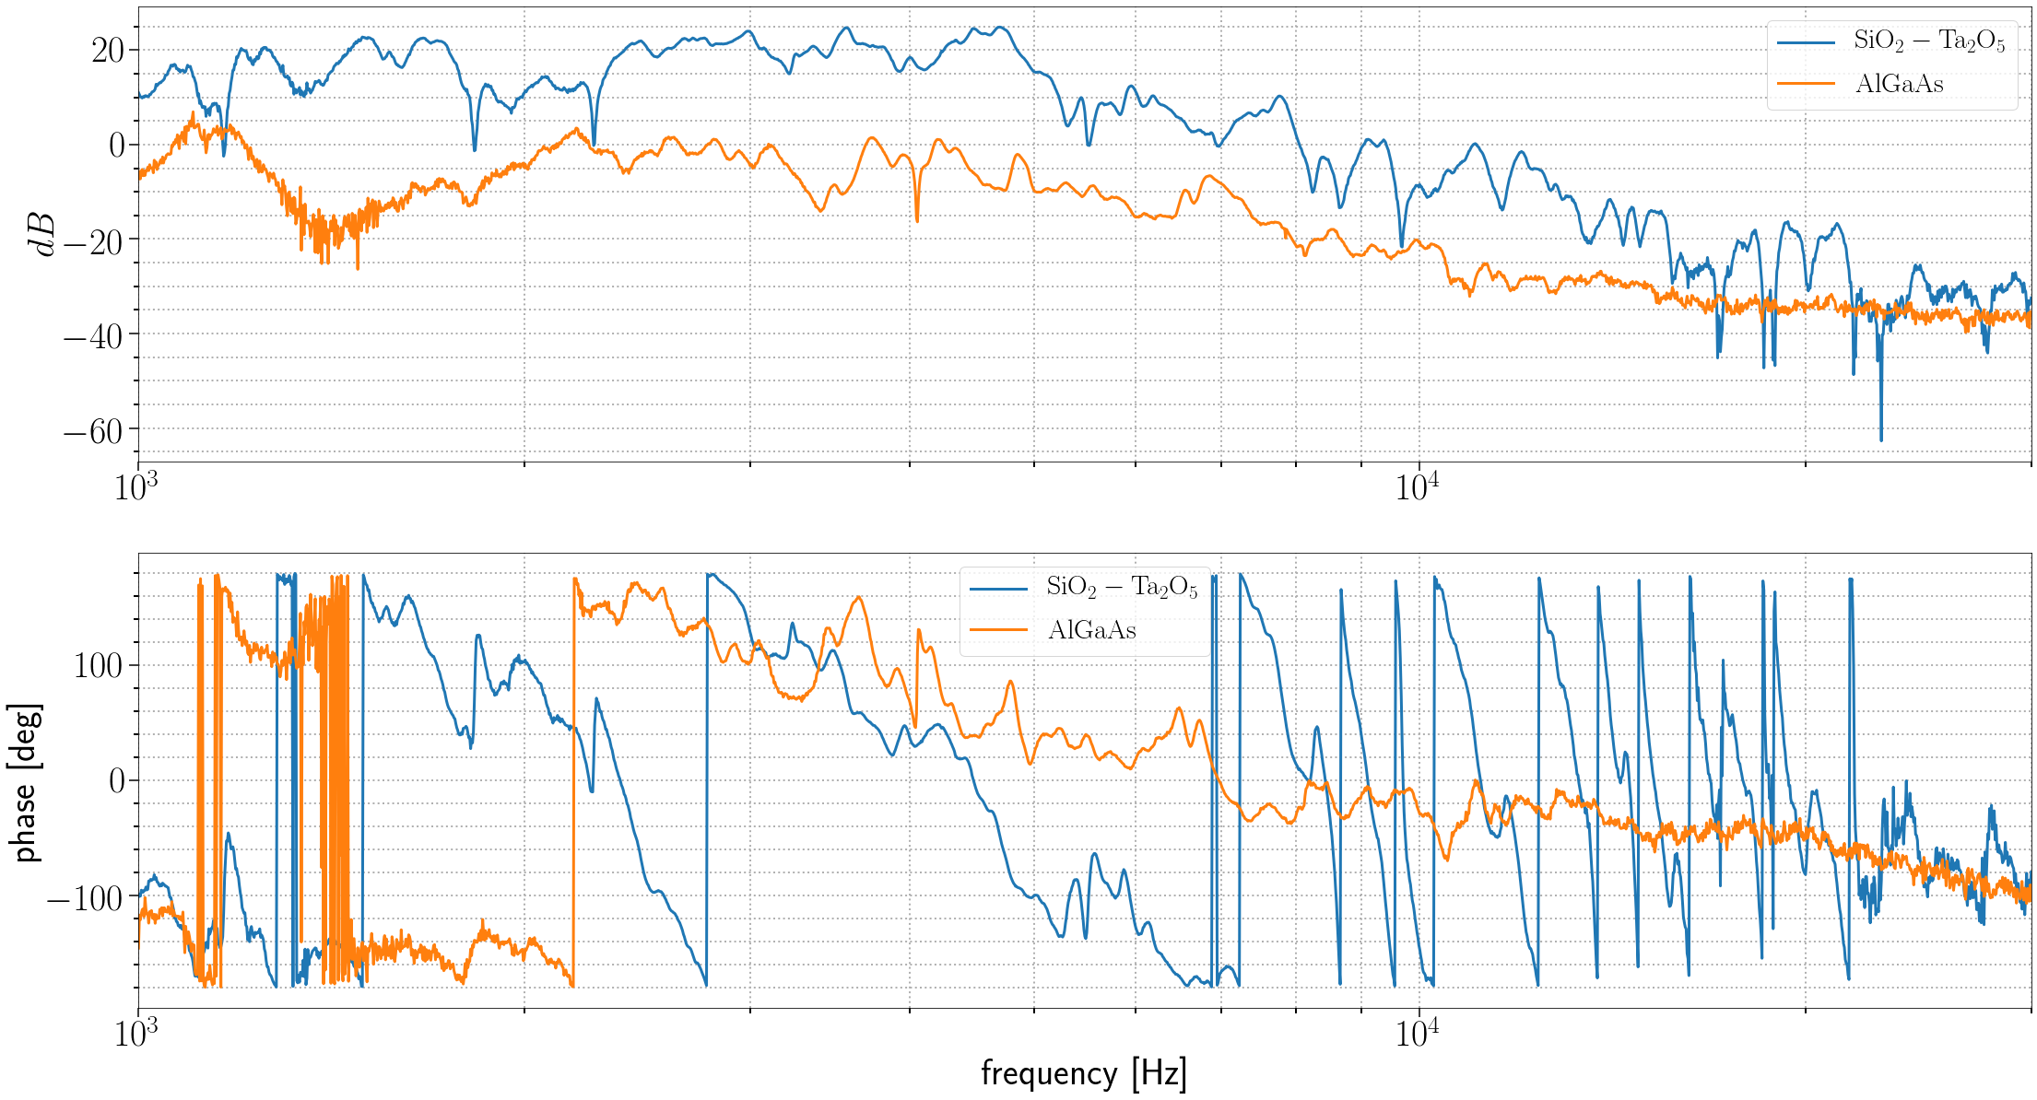
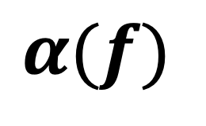
$$α(f)$$

Slide 17
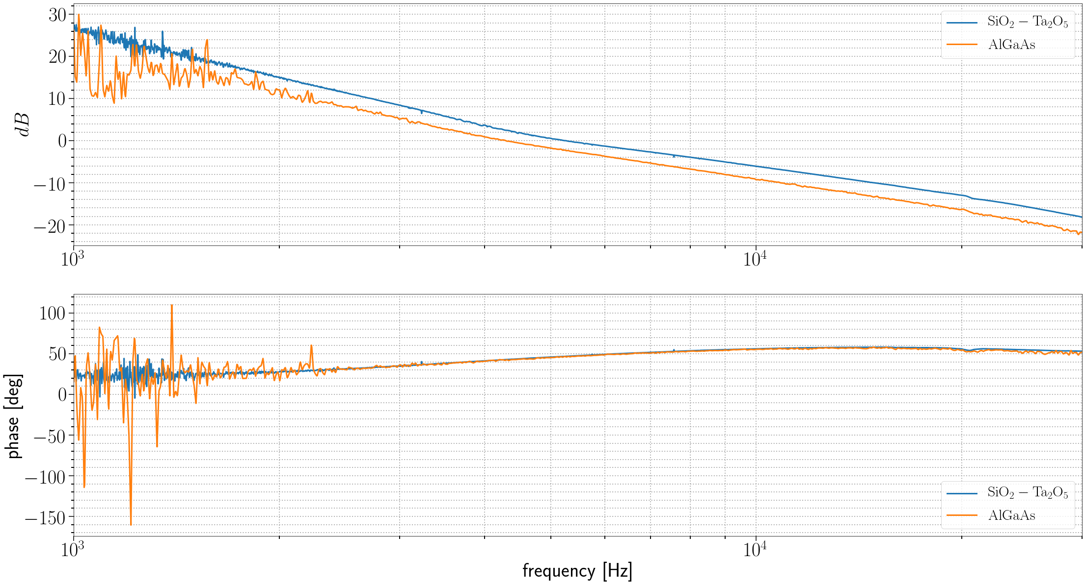
OLG

Slide 18
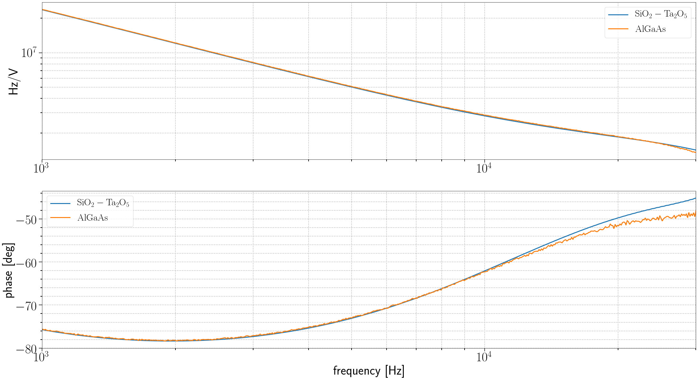
A(f)

Slide 19
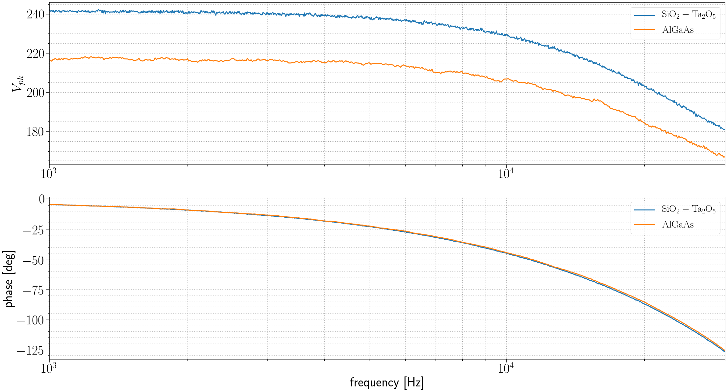
Voltage on front electrode plate (swept frequency measurement)

Slide 20
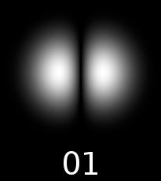
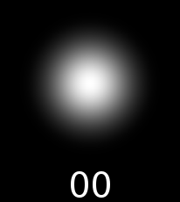
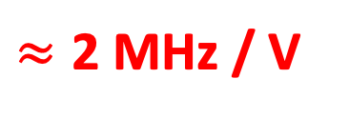
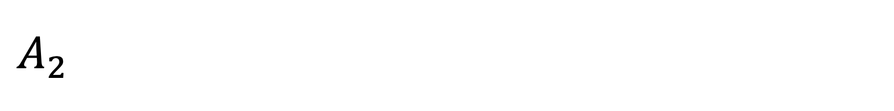
$$A_{2}$$
$≈\text{2}$ MHz / V
FSR
Notes:
Laser PZT response
Between first TEM00 and HG01 mode 1946923 Hz / V
Between first TEM00 and second TEM00 mode 2009867 Hz / V

